Slide 1

DonorDataAnalysis
March2017

Slide 2
Note
Fiscal Year = June 1st to May 31st
Amounts are in Hong Kong Dollars

Slide 3
Newly Acquired Households
FY | Total Households Newly Donated | Gave in subsequent years
2016-17 | 856
2015-16 | 505
2014-15 | 745
2013-14 | 1,697
FY | Total Households Newly Donated | Gave in subsequent years
2017-18 | 88 | -
2016-17 | 713 | 63
2015-16 | 390 | 102
2014-15 | 639 | 136
2013-14 | 1,684 | 213
Notes:
Newslidefornewlyacquired
Howmuchdidtheygave
Howmany
Didtheygiveagain
Vsonlygaveonce?

Slide 4
Yearly Comparison
FY | Donations From Individuals HK$ | Average Amount/ Household | Total # of Individual Contacts | Current Year Active Households | Total Households | Total Households Newly Donated | Previous Donor Household Drop-off
2016-17 | $27,563,951 | $22,893 | 16,428 | 1,204 |  | 856 | 392(year not over)
2015-16 | $34,175,771 | $40,112 | 14,297 | 852 |  | 505 | 572
2014-15 | $36,102,850 | $32,910 | 12,379 | 1,097 |  | 745 | 1,402
2013-14 | $31,430,201 | $14,326 | 10,264 | 2,194 |  | 1,697 | 434
Notes:
20170601
Totalhouseholdsnewlyacquiredthatgave
Howmanygaveintheyearsafter?
Total#ofContacts–UsedCreatedDate
PreviousDonorDrop-off–Gaveinpreviousyearbutdidnotgivethisyear
TotalDonorsNewlyAcquired(1stGiftinacertainFY)

Slide 5
Yearly Comparison
FY | Donations From Individuals HK$ | Average Amount/ Household | Total # of Individual Contacts | Current Year Active Households | Total Households | Total Households Newly Donated | Previous Donor Household Drop-off
2017-18 | $103,212,132 | $84,739 |  | 477
2016-17 | $102,897,659 | $35,990 | 16,428 | 1,241 |  | 856 | 392
2015-16 | $113,955,237 | $51,586 | 14,297 | 893 |  | 505 | 572
2014-15 | $158,514,368 | $63,431 | 12,379 | 1,093 |  | 745 | 1,402
2013-14 | $99,054,036 | $29,090 | 10,264 | 2,146 |  | 1,697 | 434
Notes:
2017 06 01
Total households newly acquired that gave
How many gave in the years after?
Total#ofContacts–UsedCreatedDate
PreviousDonorDrop-off–Gaveinpreviousyearbutdidnotgivethisyear
TotalDonorsNewlyAcquired(1stGiftinacertainFY)

Slide 6
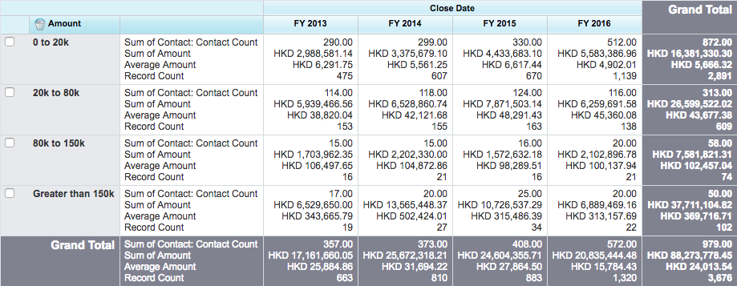
Individual Donations Over Time

Slide 7
Individual Donations Over Time
 |  | FY2013 | FY2014 | FY2016 | FY2016 | FY2017
0-20k | Total | $10,343,974 | $8,048,064 | $8,966,357 | $10,184,054 | $3,267,470
 | Average | $3,556 | $4,056 | $5,657 | $4,369 | $4,488
20-80k | Total | $14,840,261 | $15,612,948 | $19,347,982 | $14,912,136 | $16,168,117
 | Average | $40,218 | $43,980 | $44,478 | $42,851 | $47,977
80-150k | Total | $4,395,542 | $4,457,502 | $4,888,842 | $7,521,070 | $5,827,536
 | Average | $104,656 | $106,131 | $104,018 | $107,444 | $112,068
150k+ | Total | $69,474,259 | $130,395,854 | $80,752,056 | $70,280,399 | $77,949,010
 | Average | $1,362,240 | $1,650,580 | $661,902 | $836,671 | $917,047
Notes:
Household count?
Household giving vs transactions
Allocations of the donations
ContactCount–Numberofuniquedonors
RecordCount–Numberofdonations(transactions)
Notes:
Anypotentialtomove0-20kdonorstohigherastheyarethelargestpoolofpeople?
Anypotentialtomove20k–70kdonorsup?
Decreasein20-70kdonorsovertheyears
StagnantGreaterthan100kbutperhapstheyaredifferentpeople?Lookatwhothesepeopleare?

Slide 8
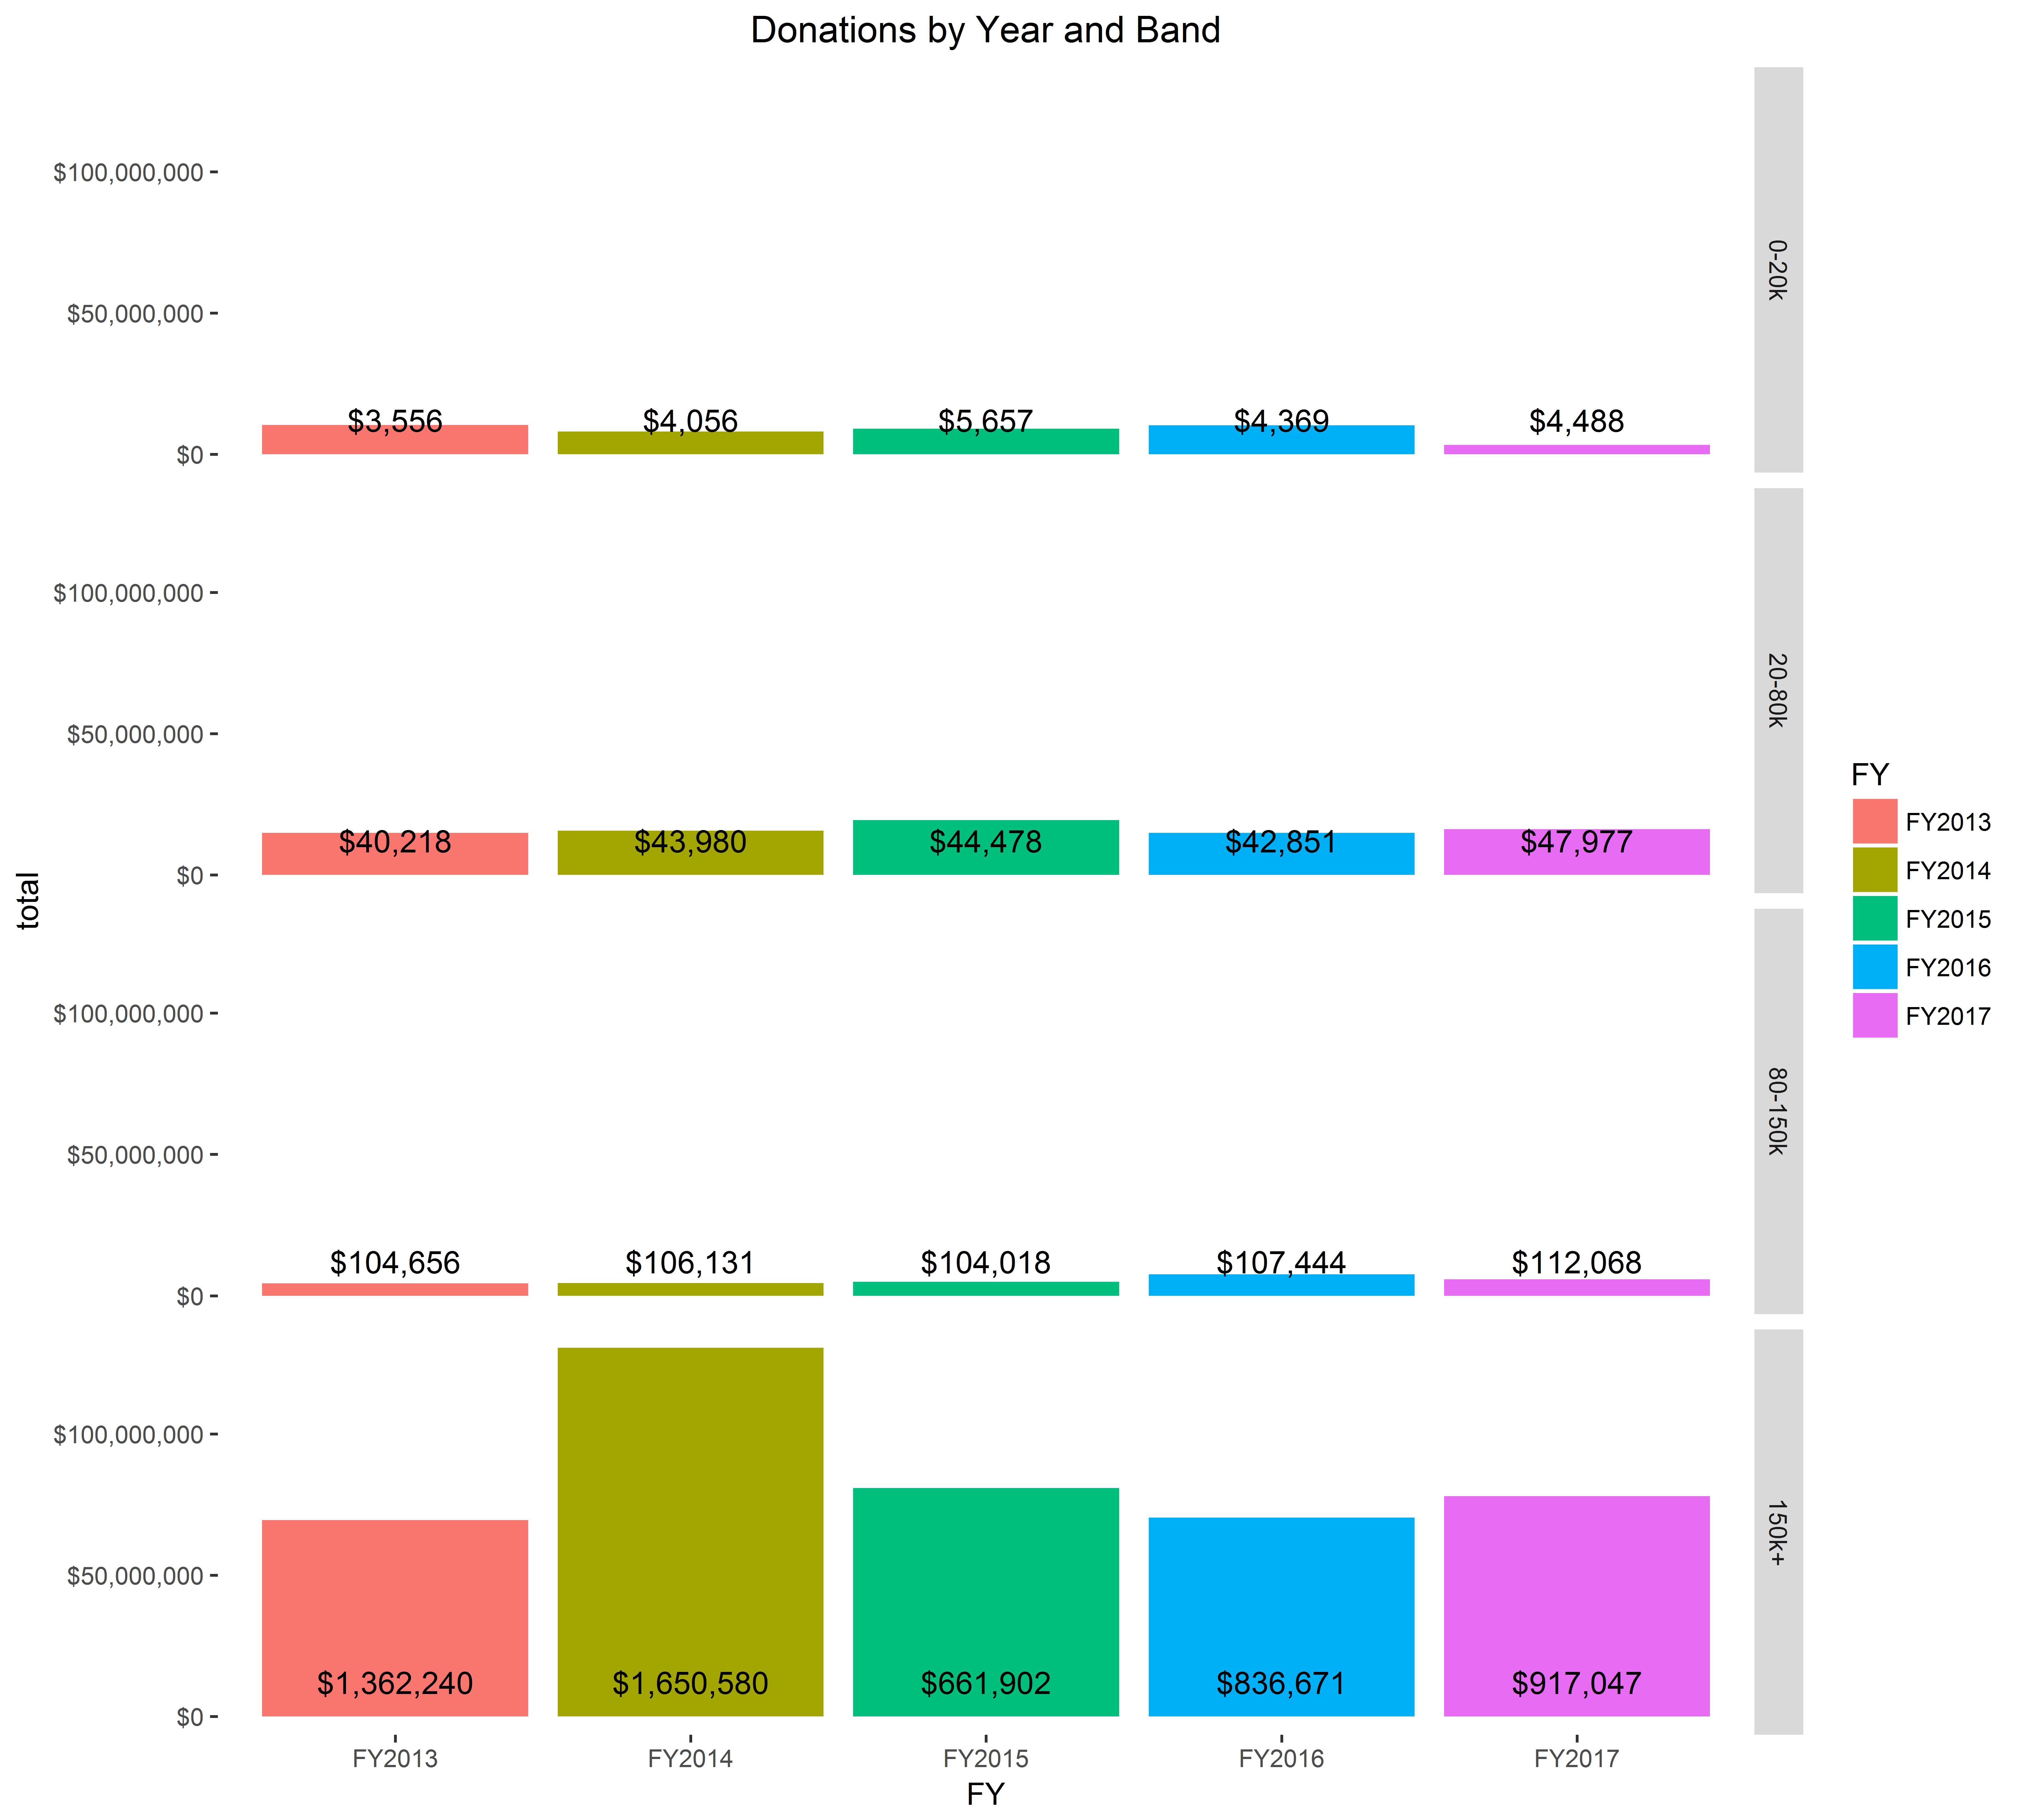
Individual Donations Over Time
$150K+ donors contribute most of total funding
Large donations also the most volatile
Annotations denote average donation
Notes:
Household count?
Household giving vs transactions
Allocations of the donations
ContactCount–Numberofuniquedonors
RecordCount–Numberofdonations(transactions)
Notes:
Anypotentialtomove0-20kdonorstohigherastheyarethelargestpoolofpeople?
Anypotentialtomove20k–70kdonorsup?
Decreasein20-70kdonorsovertheyears
StagnantGreaterthan100kbutperhapstheyaredifferentpeople?Lookatwhothesepeopleare?

Slide 9
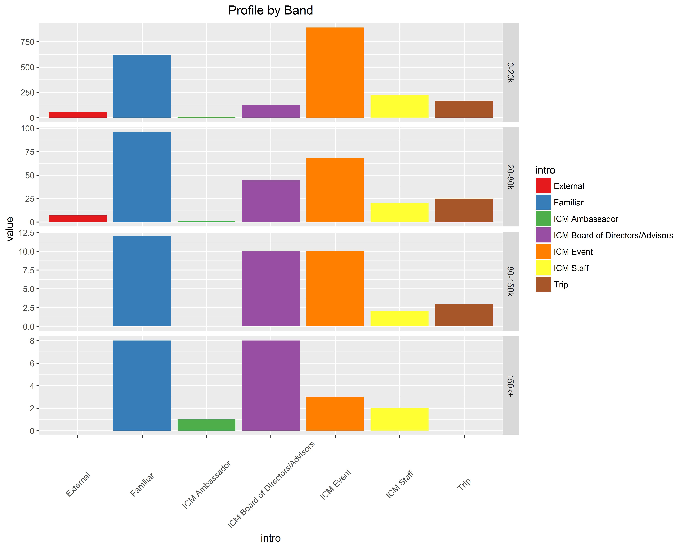
High Donor Profile
Major donors are mainly either friends of ICM or introduced via the Board

Slide 10
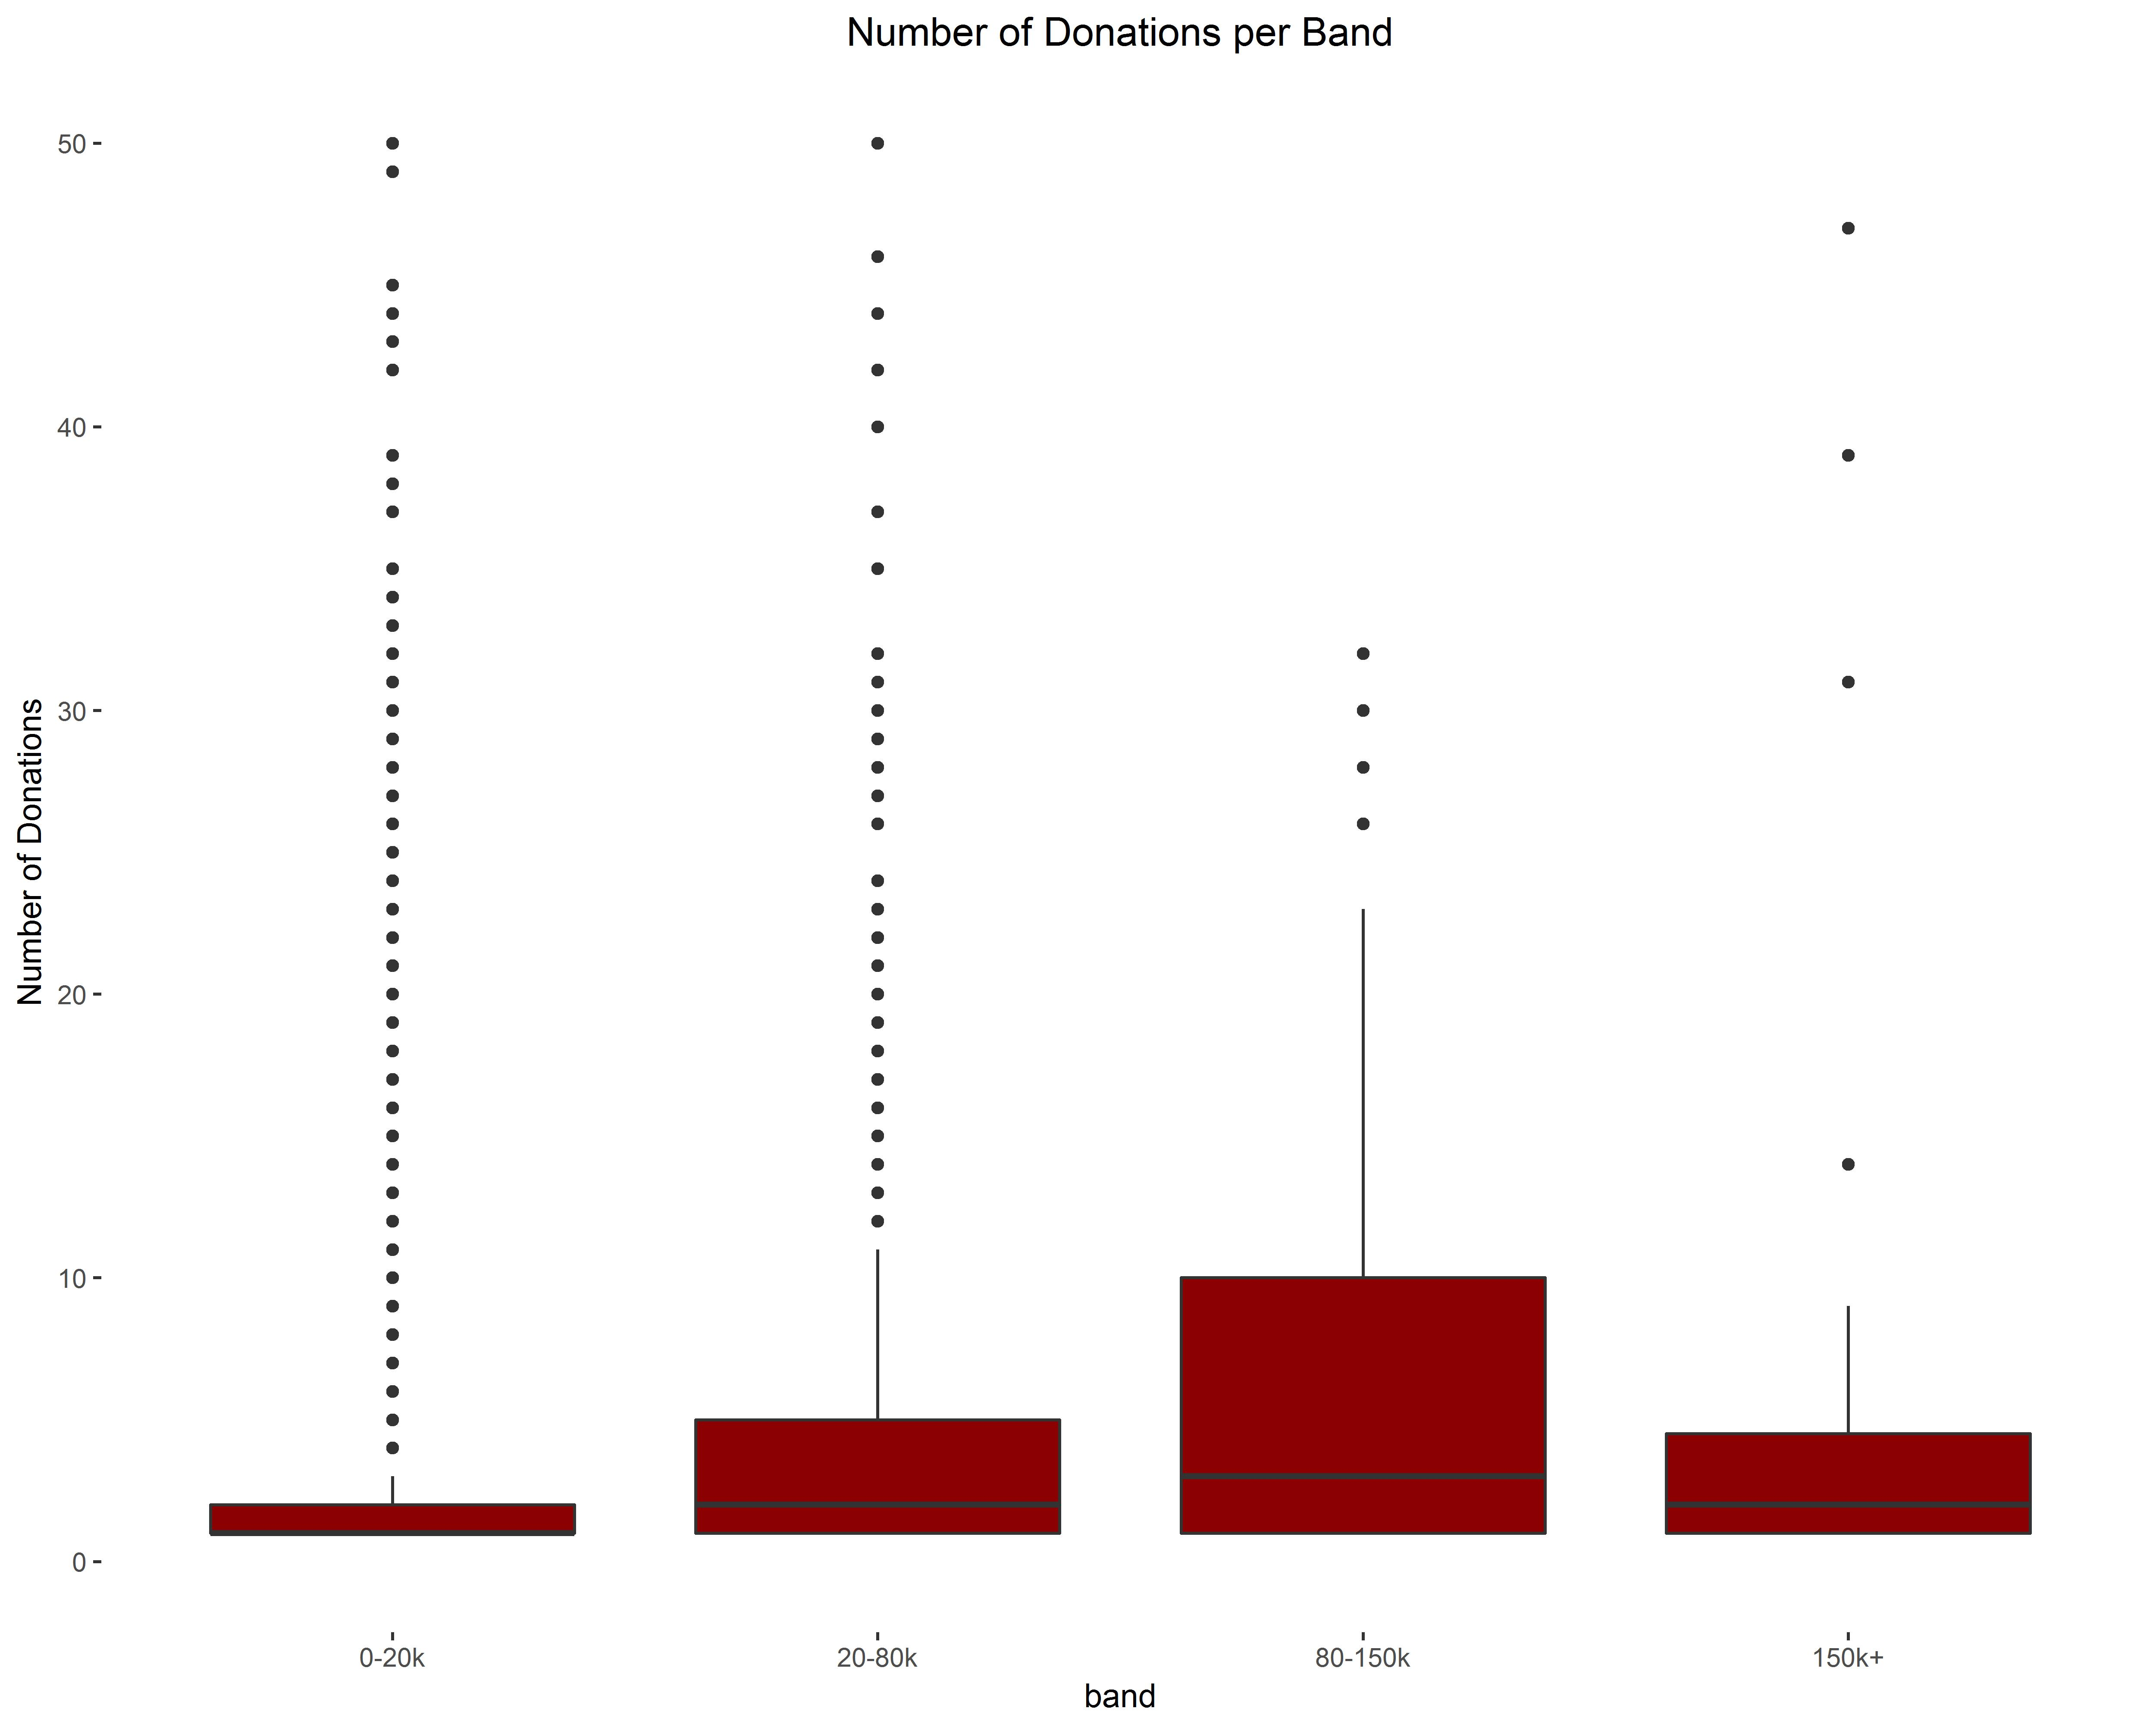
Do
Major donors are typically low frequency donors.
The band with the most multiple donors (P75 = 10 times) is the 80-150K band
Next steps: identify what makes someone in the 80-150K band likely to donate multiple times

